Slide 4
Robot 1
Robot 2
Robot 1
Robot 2

Slide 5
Robot 1
Robot 1

Slide 6
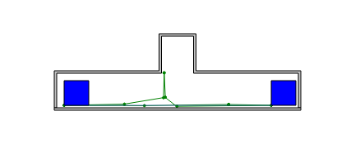

Slide 7
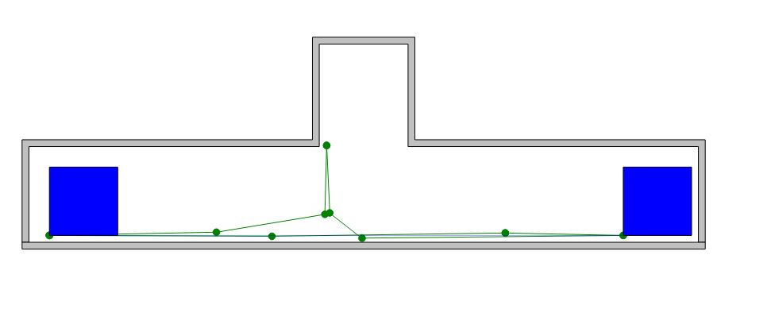

Slide 8
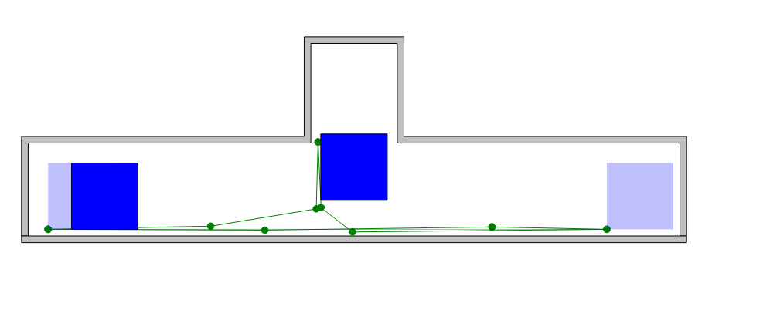

Slide 9
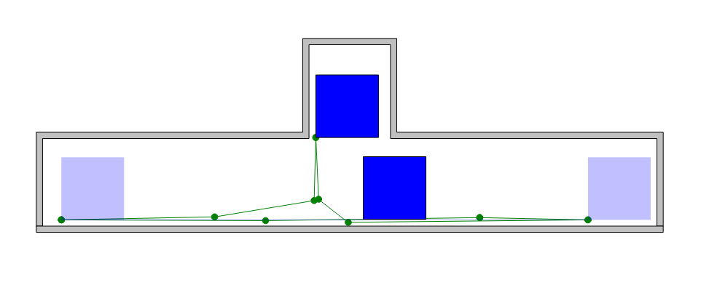

Slide 10
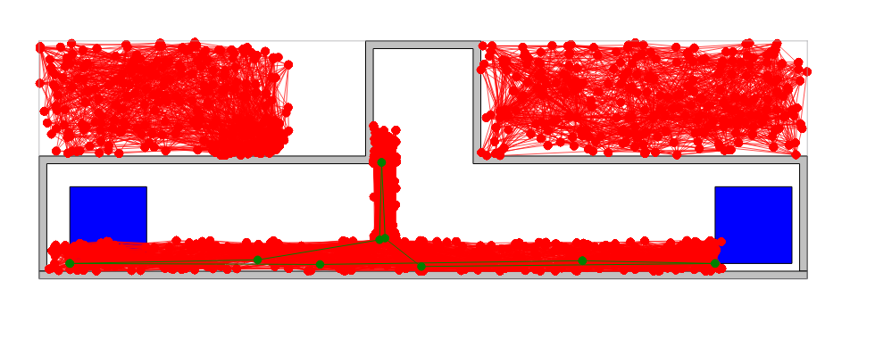

Slide 11


Slide 12
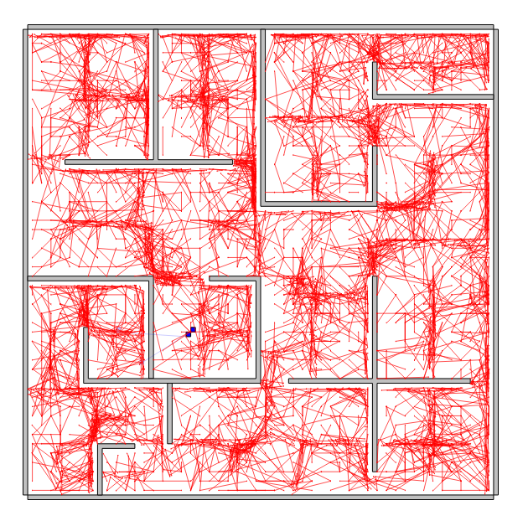
Notes:
N = 5000
k-=1 WITH reward distance

Slide 13
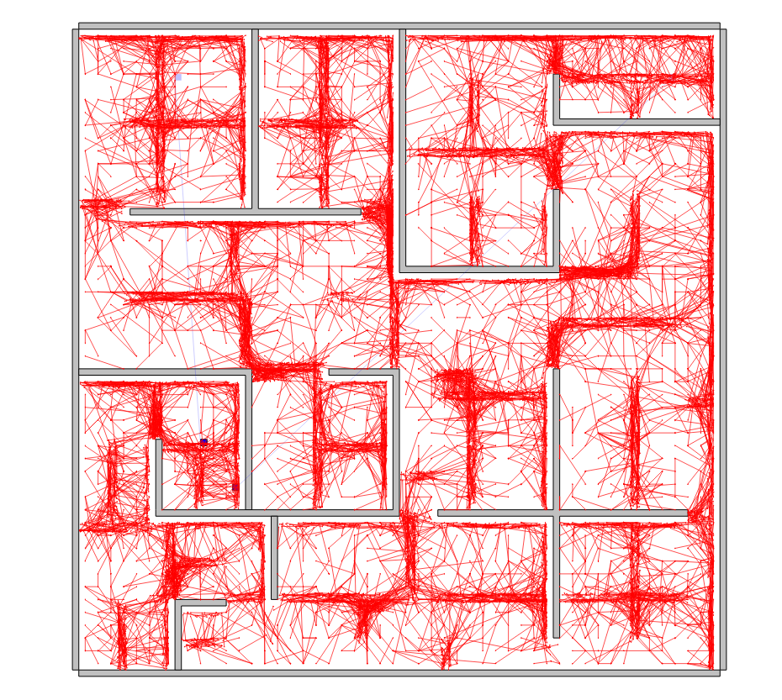
Notes:
N = 10000
k-=1 WITH no reward

Slide 14
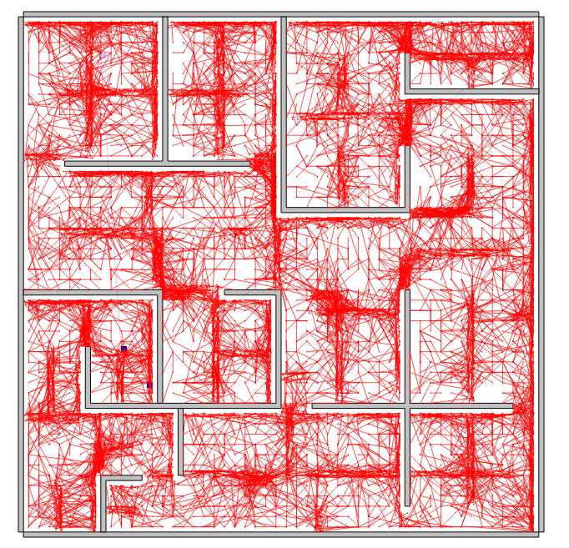
Notes:
N = 10000
k-=1 WITH distance reward

Slide 15
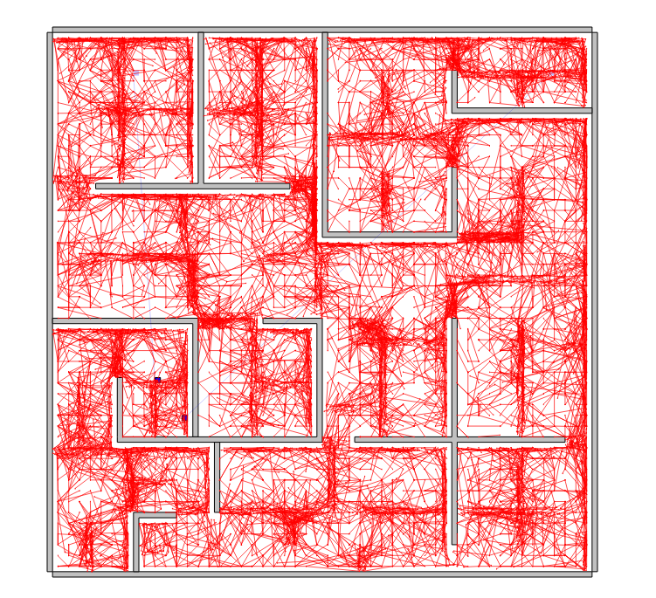
Notes:
k-=1 WITH 2* distance reward

Slide 16
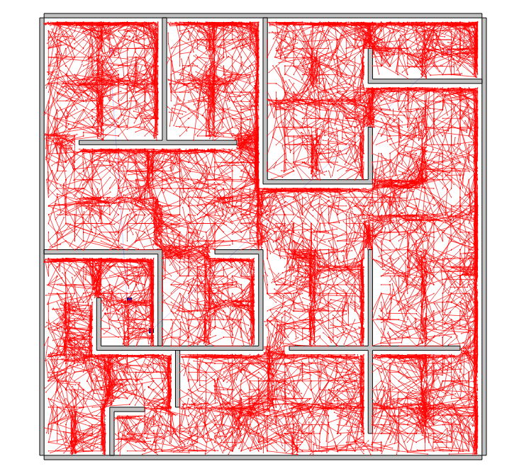
Notes:
k-=1 WITH 100* distance reward

Slide 17
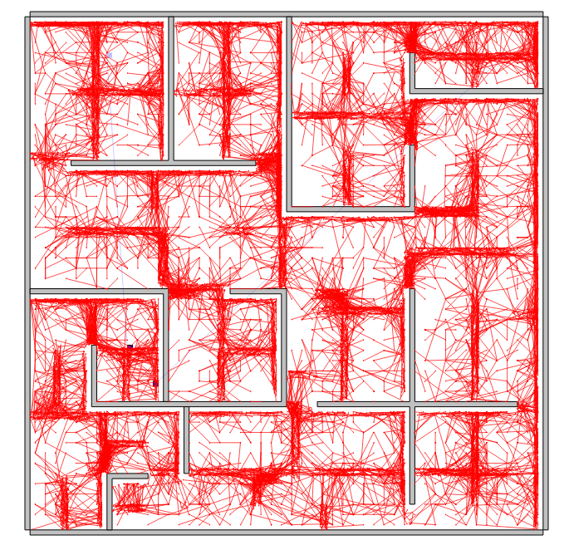
Notes:
N = 10000
k-=1 WITH no reward
No scale

Slide 18
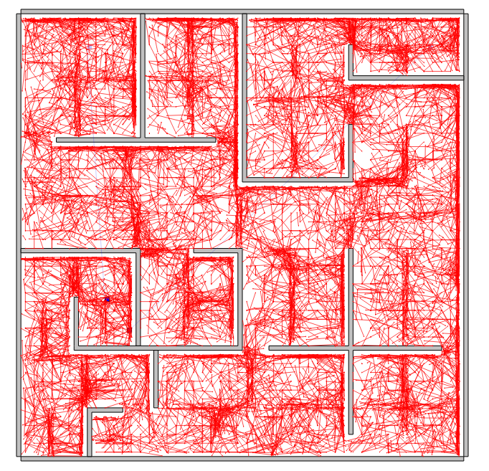
Notes:
N = 10000
k-=1 WITH reward
No scale

Slide 19
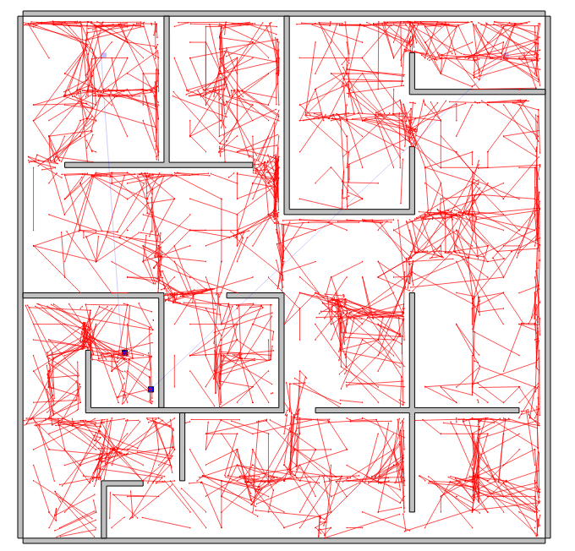

Slide 20
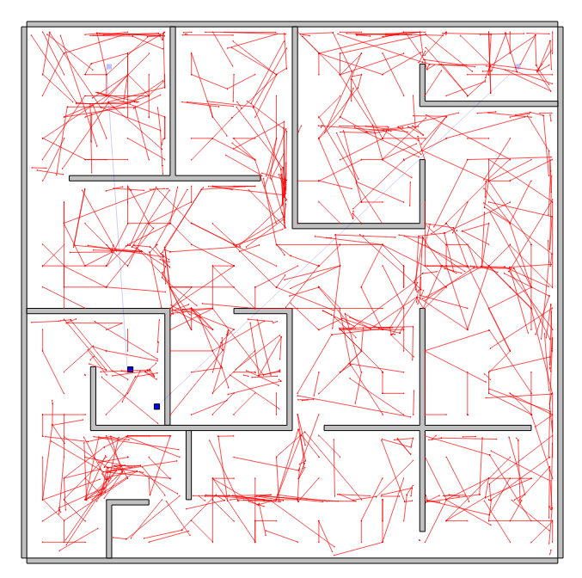

Slide 21
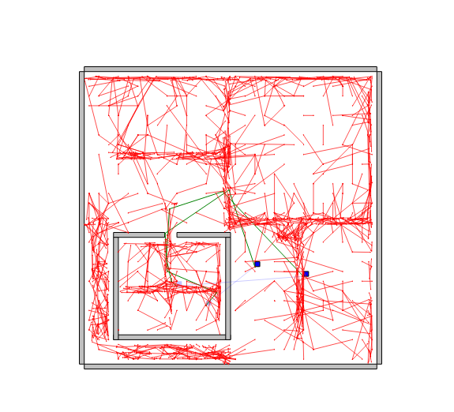
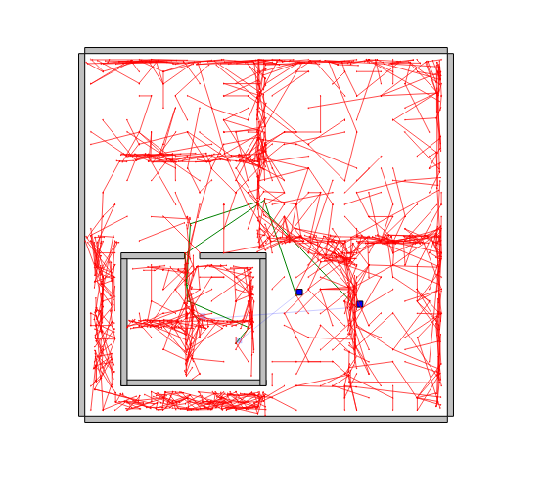
Notes:
N=1000
k-=1 WITH no reward
No scale

Slide 22
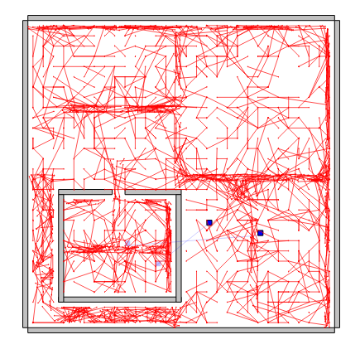
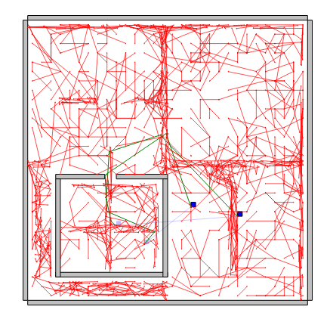
Notes:
N=1000
k-=1 WITH reward
No scale

Slide 23
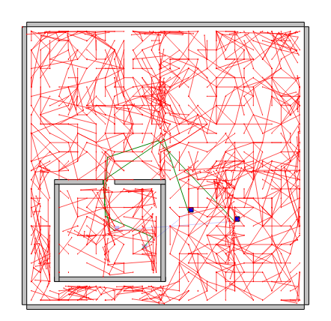
Notes:
N=1000
k-=1 WITH reward and adjust reward
No scale

Slide 25
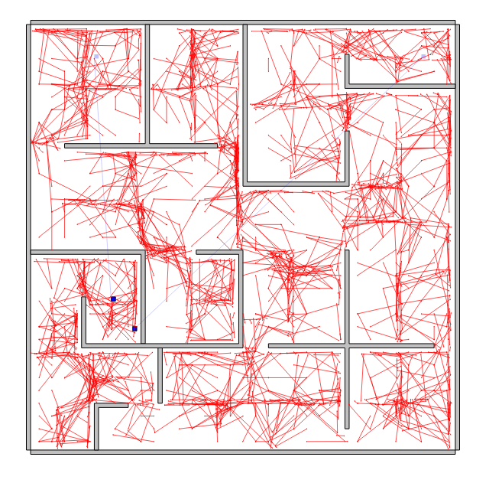
Notes:
No update (zero reward) n =2000
K=1

Slide 26
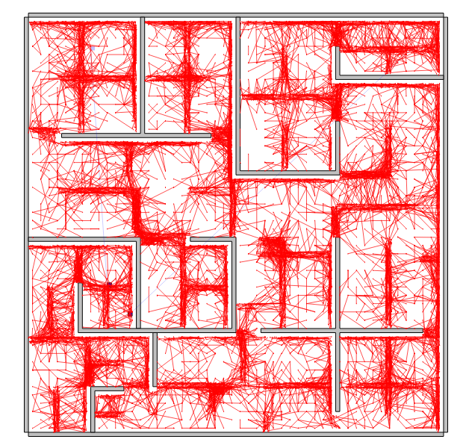
Notes:
No update (zero reward) n =10000
K=1

Slide 27
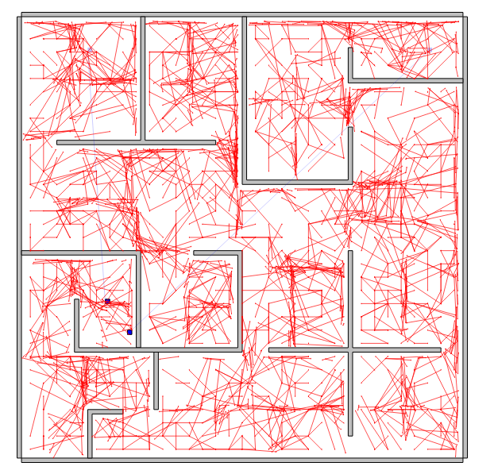

Slide 28
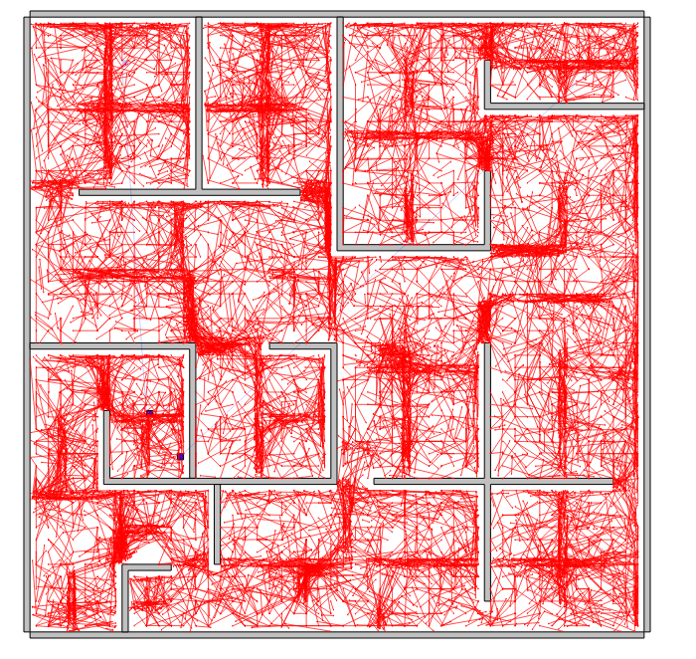

Slide 30
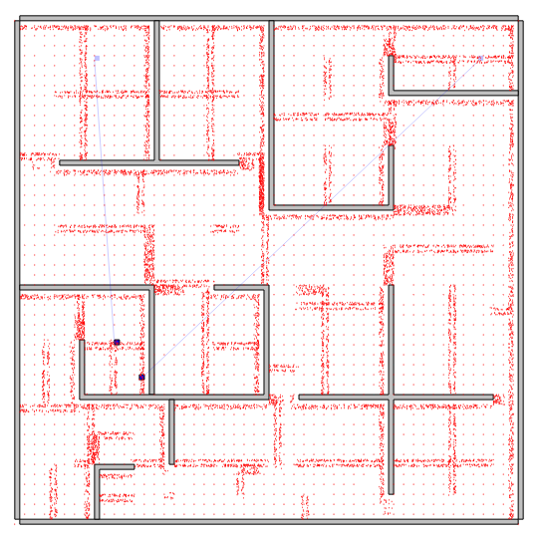
Notes:
N=10000
With reward

Slide 31
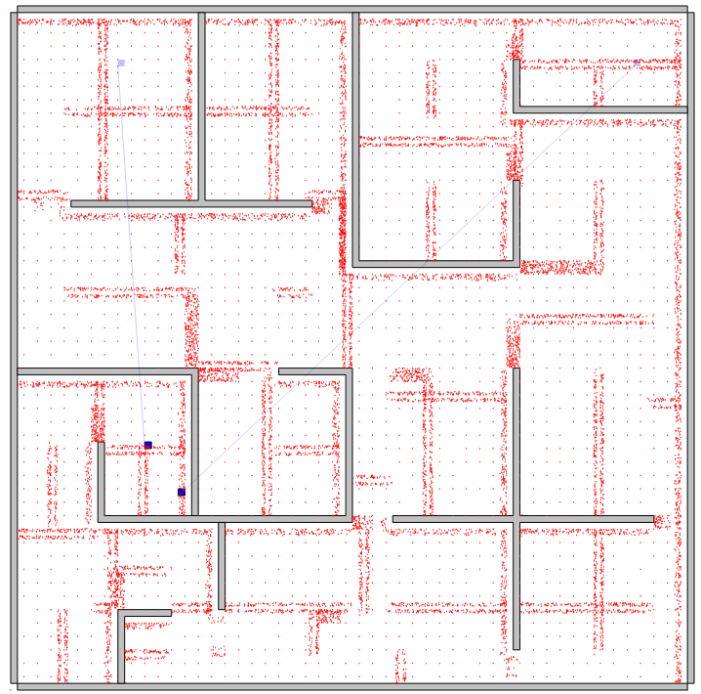
Notes:
N=10000
With no reward

Slide 32
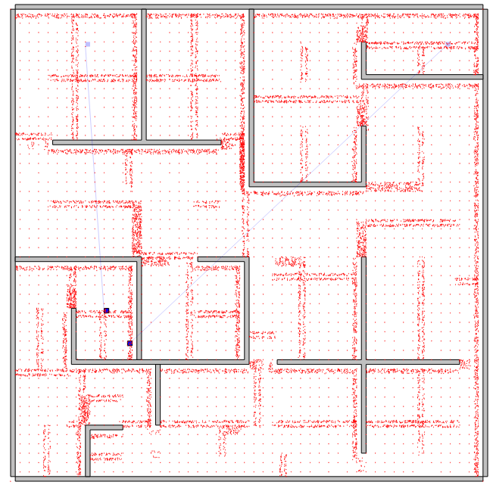
Notes:
N=10000
With and adjusted reward

Slide 33
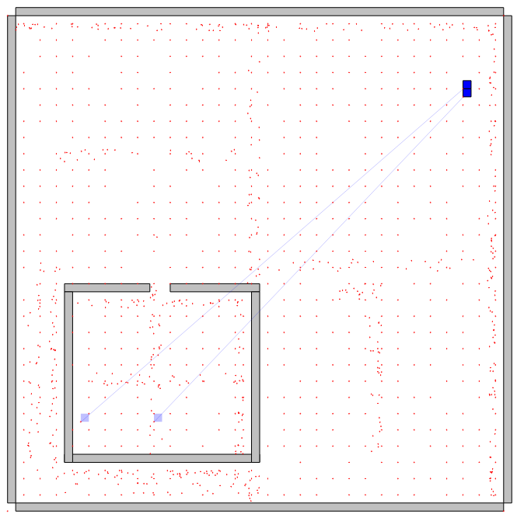
Notes:
N=1000s
With reward

Slide 34
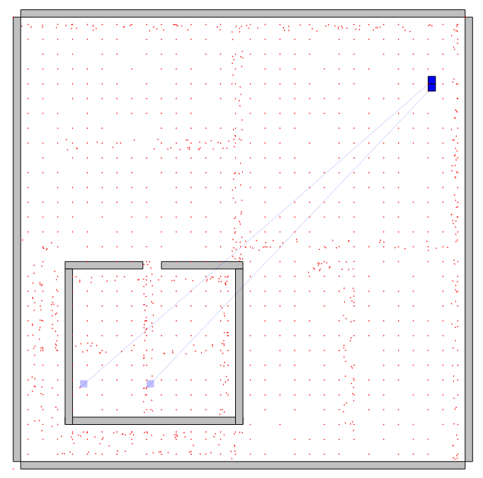
Notes:
N=1000
With and adjusted reward

Slide 35
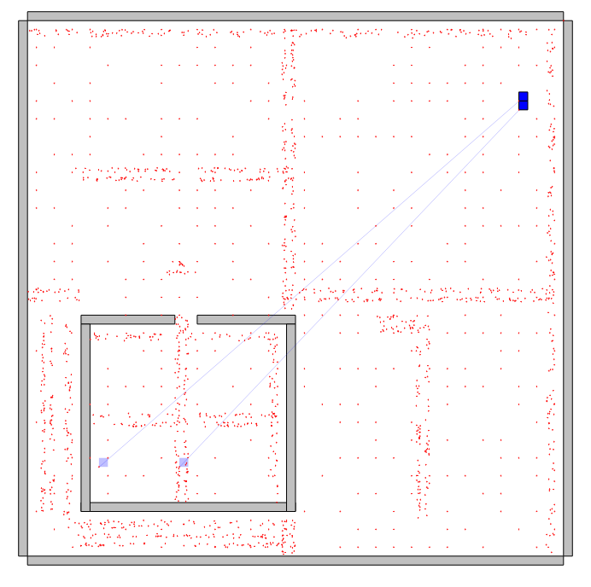
Notes:
N=1000
With no reward

Slide 37
With Uniform

Slide 38
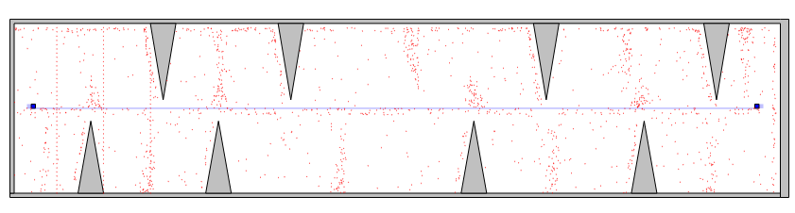
Notes:
N=1000 with no reward

Slide 39
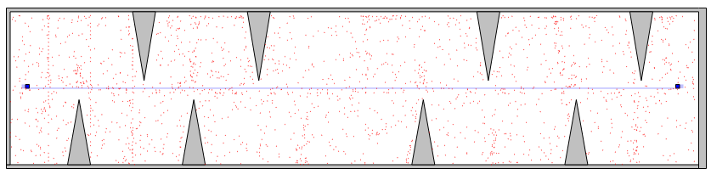
Notes:
N=1000 with adjusted reward

Slide 40
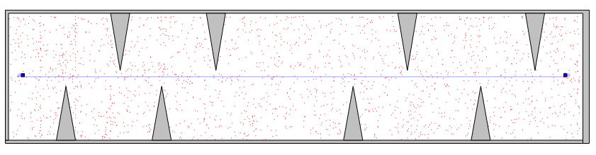
Notes:
N=1000 with reward

Slide 41
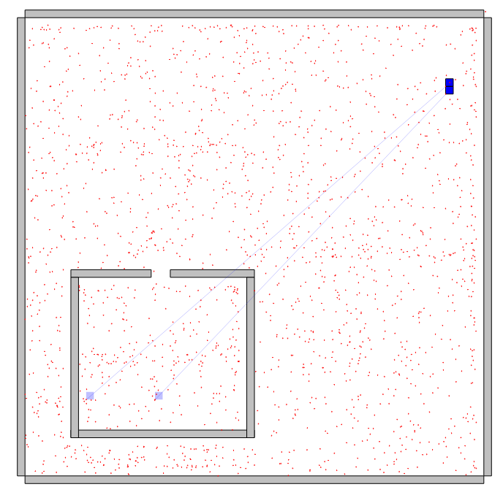
Notes:
N=1000 with reward

Slide 42
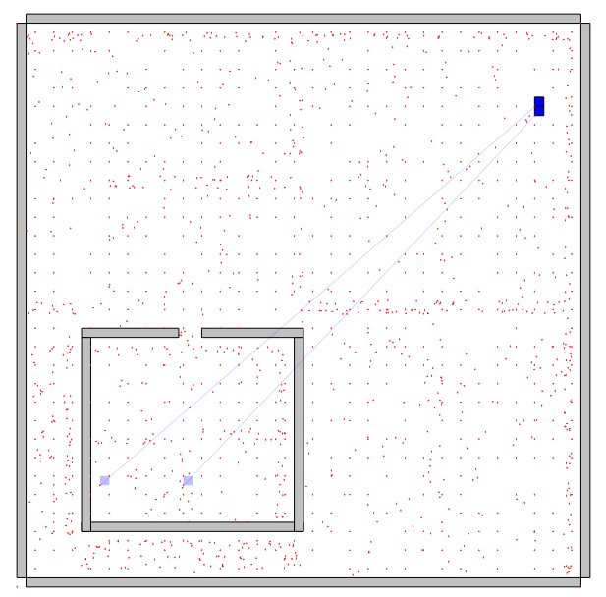
Notes:
N=1000 with adjusted reward

Slide 43
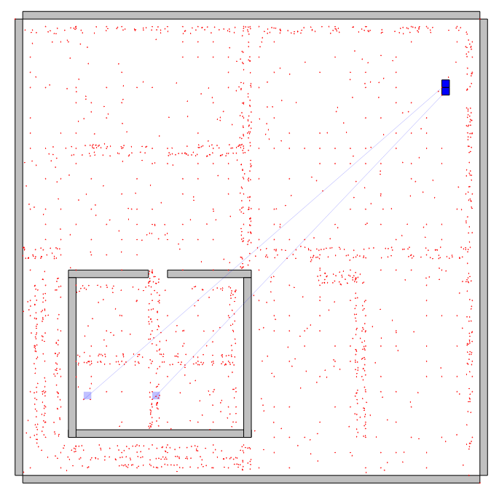
Notes:
N=1000 with no reward

Slide 44
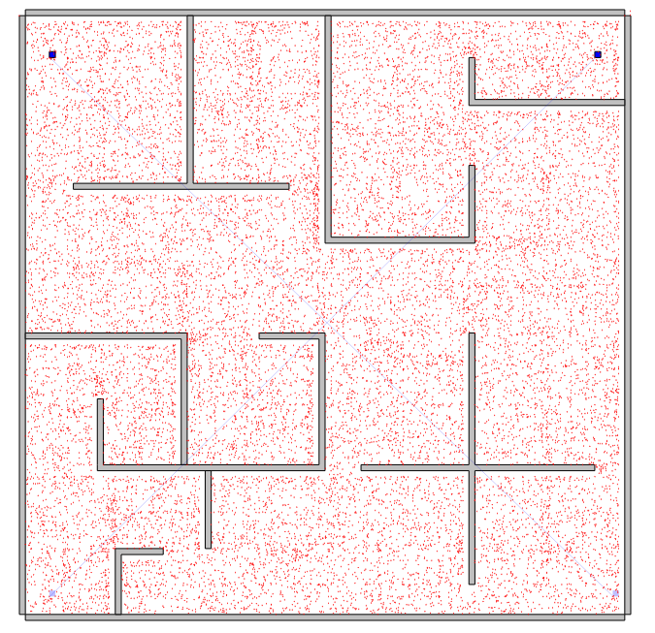
Notes:
N=10000 with adjusted reward

Slide 45
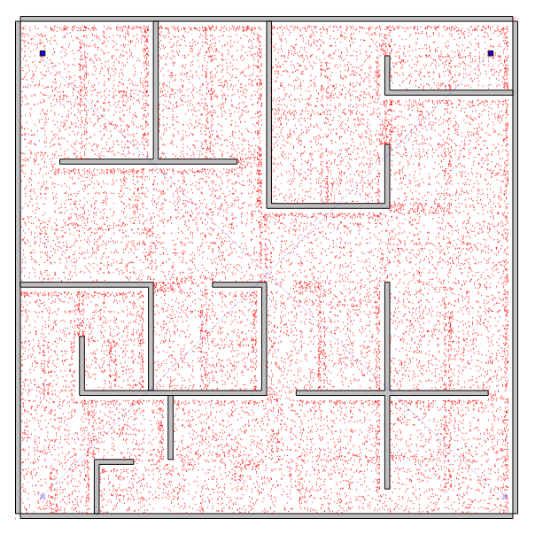
Notes:
N=10000 with reward

Slide 46
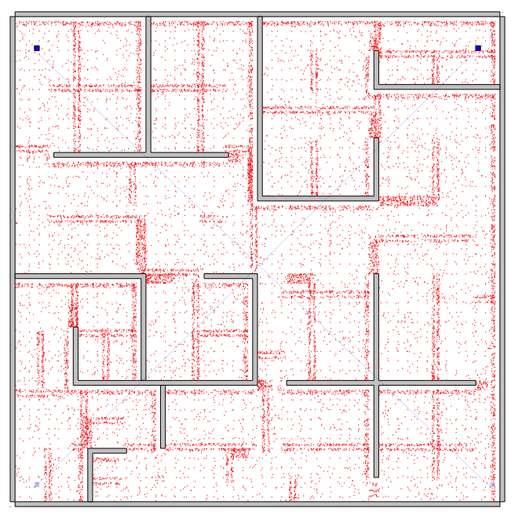
Notes:
N=10000 with no reward

Slide 48
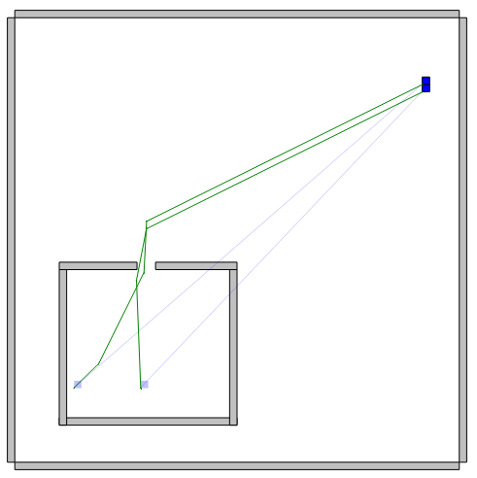
Notes:
With pair 0.2

Slide 49
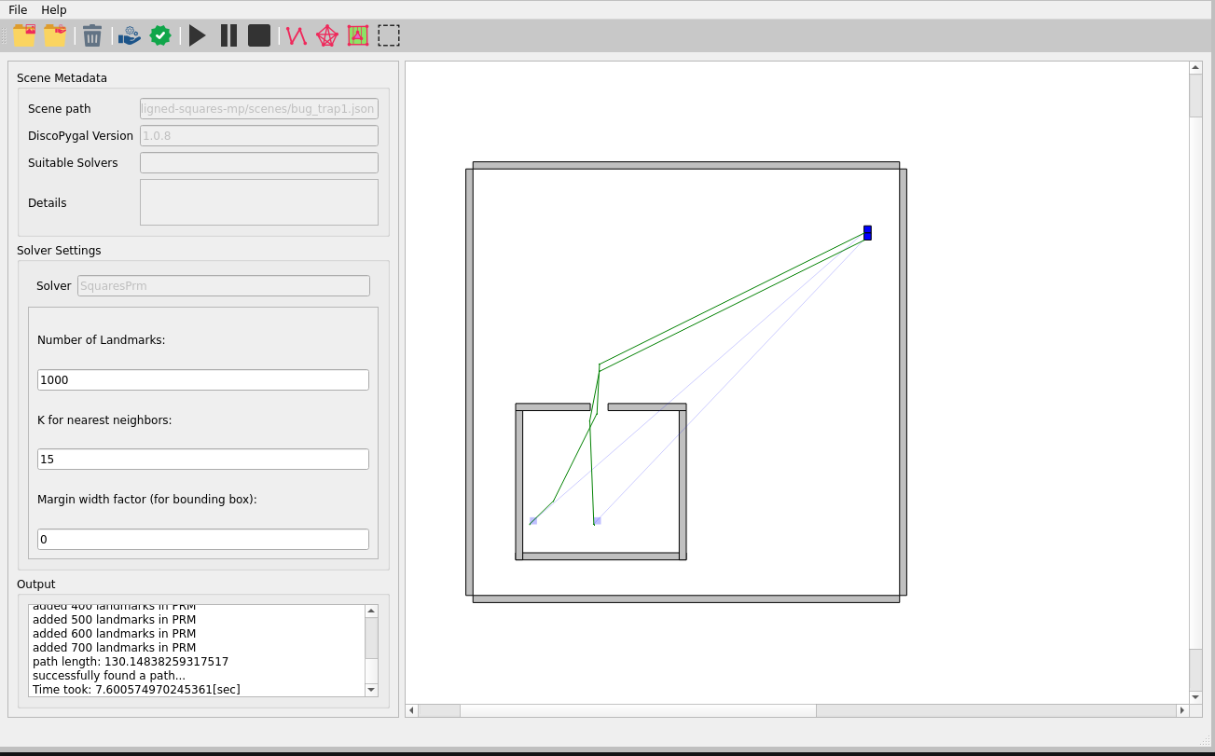
Notes:
With pairs 0.2

Slide 50
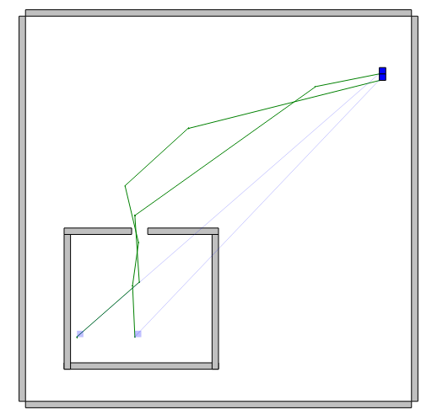
Notes:
With no pairs

Slide 51
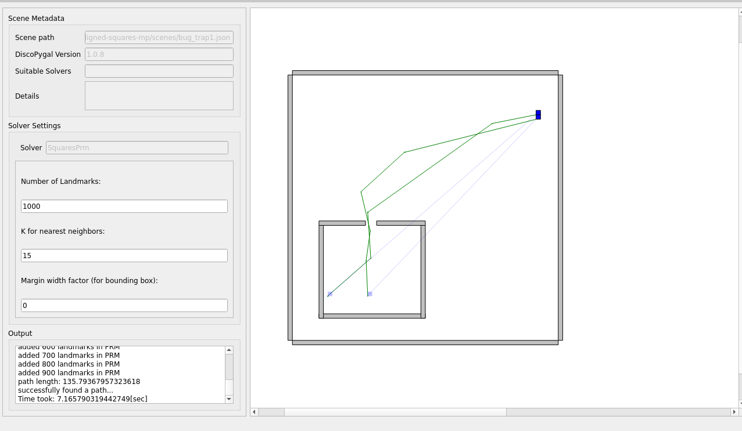
Notes:
Wito no pairs

Slide 52
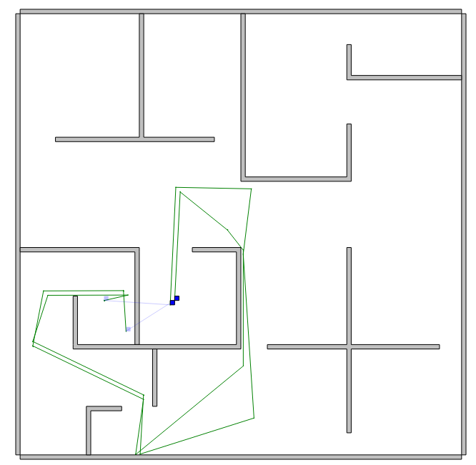
Notes:
With pairs 0.2

Slide 53
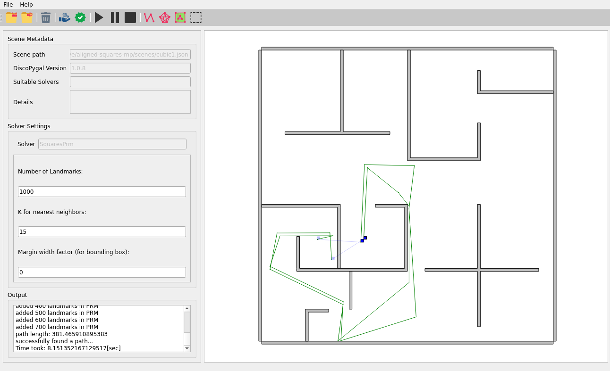
Notes:
With pairs 0.2

Slide 54
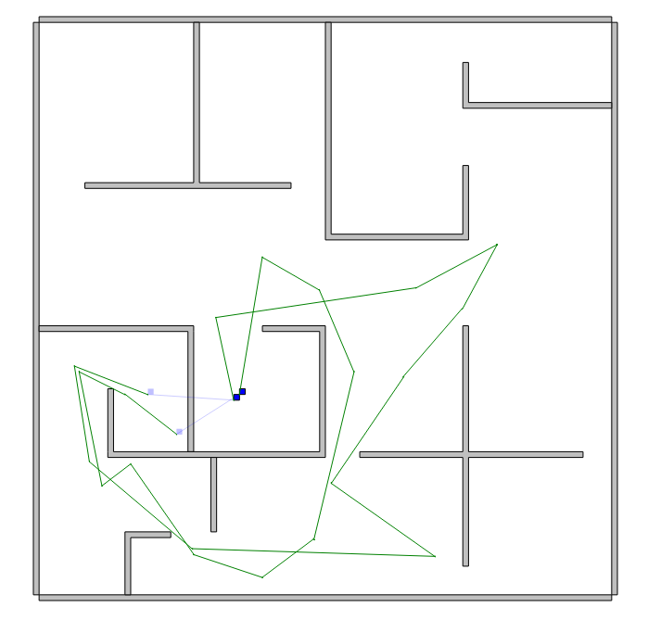
Notes:
Without pairs

Slide 55
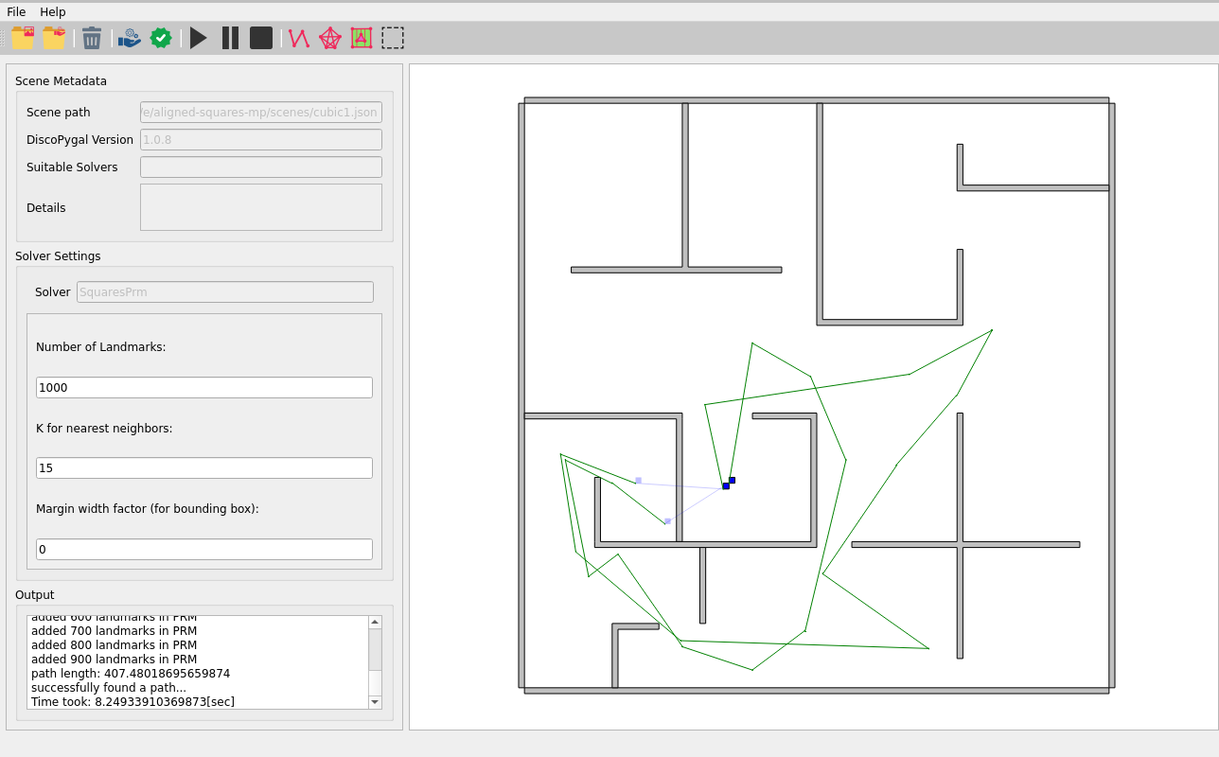
Notes:
Without pairs

Slide 56
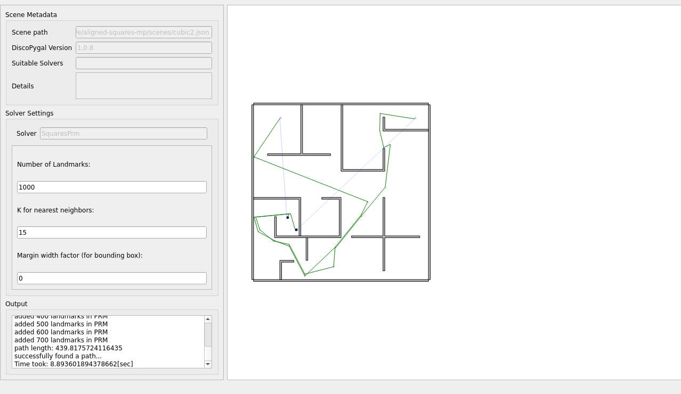
Notes:
With pairs 0.2

Slide 57
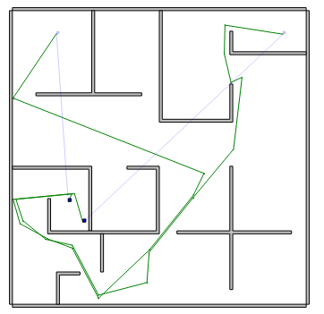
Notes:
With pairs 0.2

Slide 58
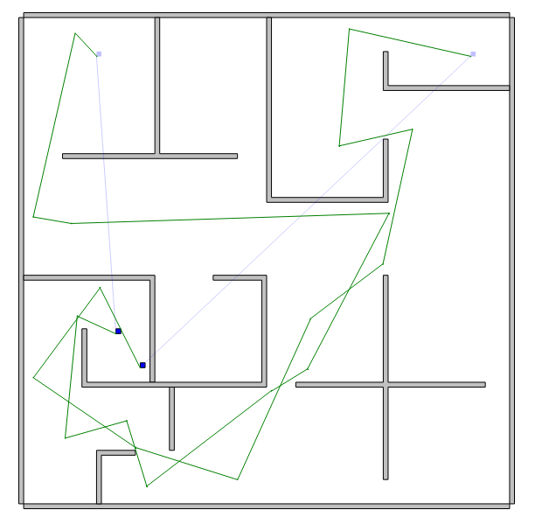
Notes:
Without pairs

Slide 59
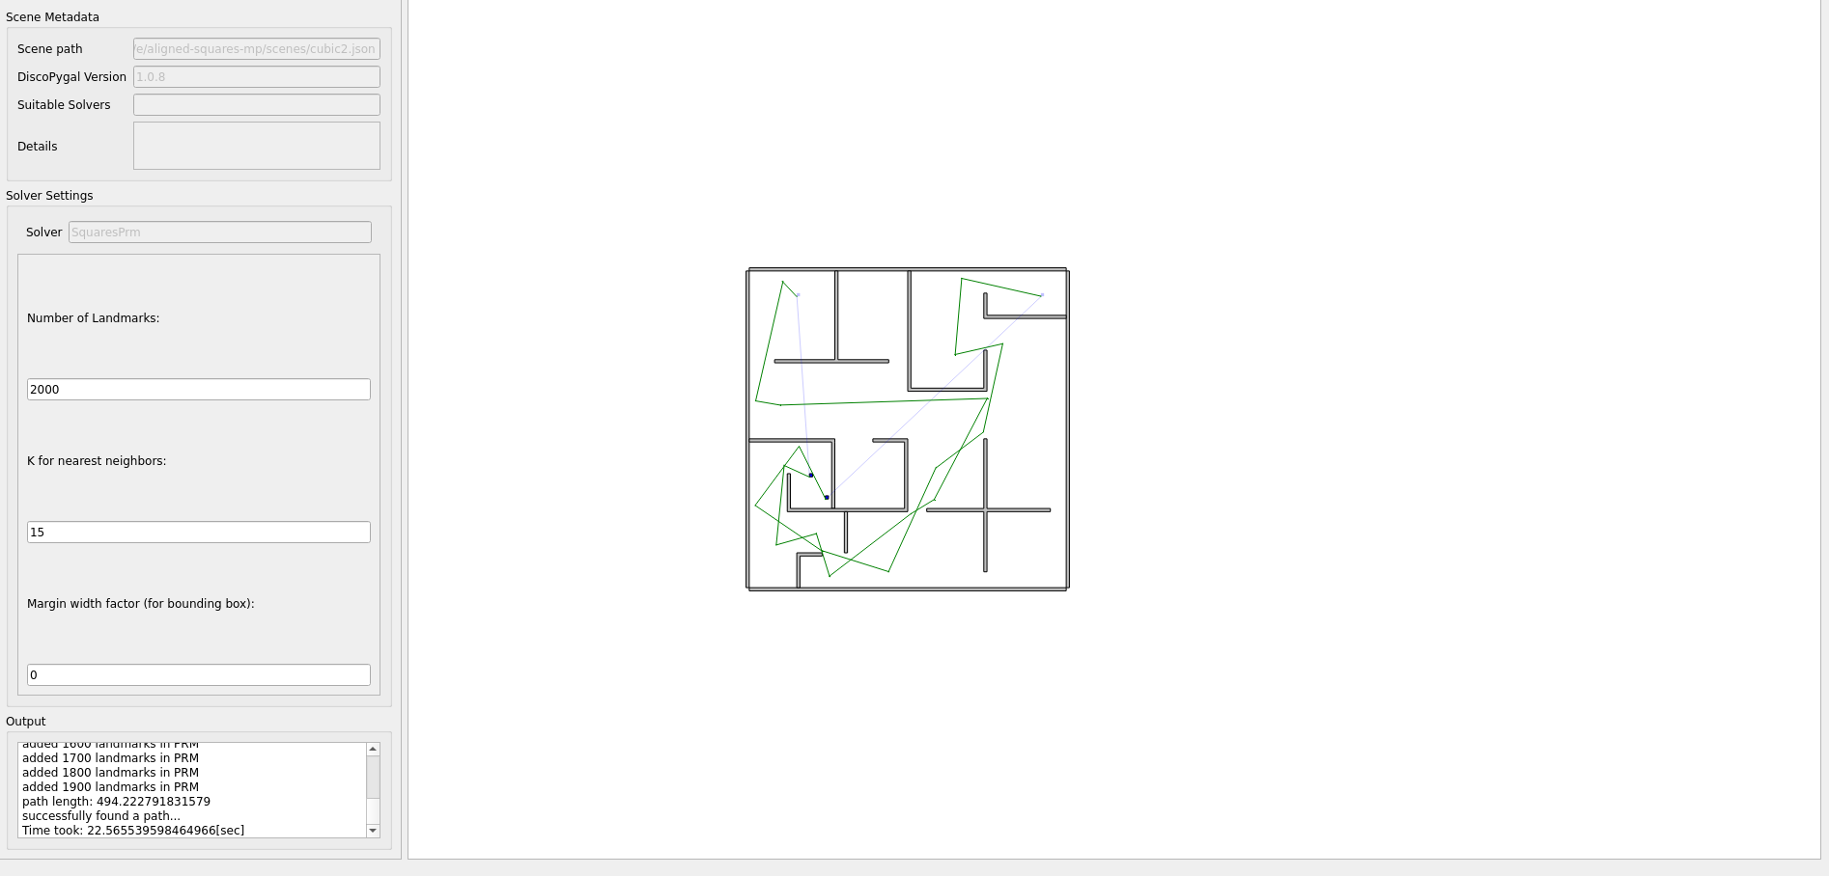
Notes:
Without pairs

Slide 60

Notes:
With pairs 0.2

Slide 61

Notes:
With pairs 0.2

Slide 62

Notes:
Without pairs

Slide 63

Notes:
Without pairs

Slide 65

Notes:
With pairs 0.2
EUC

Slide 66

Notes:
With pairs 0.2
EUC

Slide 67

Notes:
WithOUT pairs EUCLAIDEAN

Slide 68

Notes:
WithOUT pairs EUCLAIDEAN

Slide 69
Notes:
With pairs 0.2
EUC

Slide 70
Notes:
With pairs 0.2
EUC

